Slide 1
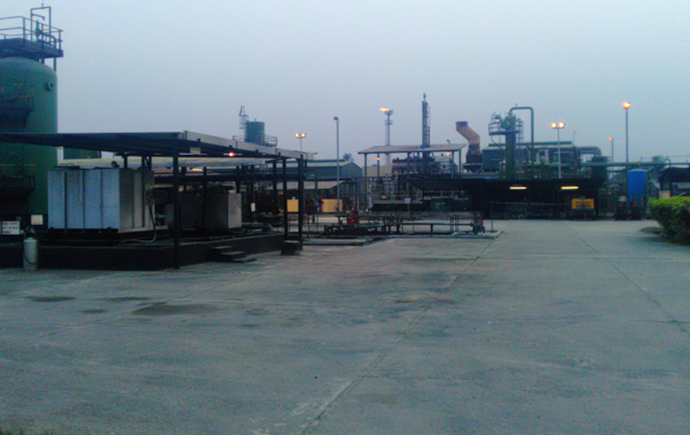
NOVEMBER YTD PERFORMANCE – CAPEX/OPEX
LAND ASSET FINANCE
Land Asset Finance

Slide 2
HIGHLIGHTS
NOVEMBER YTD Actual Expenditure (CAPEX + OPEX): $35.3m
93% of YTD phased Q4 FYLE ($37.9m).
88% of OP’17 ($39.9m) and 80% of Q4 FYLE ($44m).
NOVEMBE YTD Actual Expenditure + Commitments (CAPEX + OPEX): $37.2m
93% of OP’17 and 84% of Q4 FY LE.
CAPEX (OP’17 F$11.9m, Q4 FYLE $15.7m, NOVEMBER YTD ACT $11.3m).
November YTD Actual Burn rate at 94% of OP’17 & 72% of Q4 FYLE.
November YTD Actual Burn rate at 94% of YTD Phased Q4 FYLE ($11.3m vs $11.9m).
Well head cages of $1.05m approved for Land is included in summary below under Q4FYLE
See Capex slides for further details.
OPEX (OP’17 $27.9m, Q4 FYLE $28.3m, NOVEMBER YTD ACT $24m).
NOVEMBER YTD Actual Burn rate at 86% of OP’17 and 85% of Q4 FYLE.
NOVEMBER YTD trending at 93% of the YTD Phased Q4 FYLE. ($24m vs $26m).
See OPEX slides for further details.
Overview
CENTRAL EAST FINANCE

Slide 3
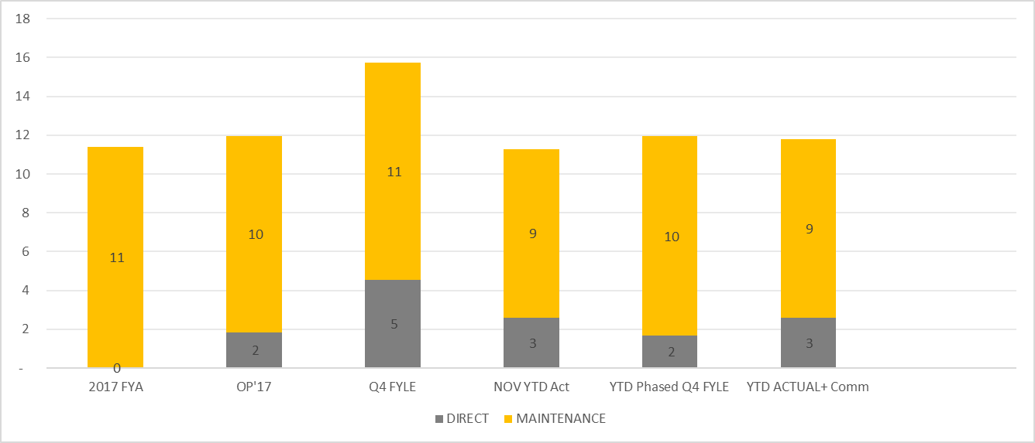
CAPEX – NOVEMBER YTD PERFORMANCE
Concerted effort to ensure early delivery of activities
LAND EAST HUB - CAPEX OVERVIEW
Variance commentary : 94% of Phased Q4 FYLE and 72% Q4 FYLE
Direct Maintenance
Performance is above plan due to the fast track of the Land head fencing activities.
Maintenance: Performance is below plan due to delay in delivery of Long lead ordered spares.
*$1.05mln approved for Well Head Cages.

Slide 4
OPEX – NOVEMBER YTD PERFORMANCE
Variance commentary : 93% of Phased Q4 FYLE and 85% Q4 FYLE
Imo River: Overspend due to repair works on vandalized newly installed W/5L tie-in spool and Imor re-routing and Enhanced surveillance and Okoloma 20K FGC Inspection and sewage dislodgement.
Almost all the PUs have overspend their Catering Q4 phased budget except Agbada and Rumuahia
Logistics cost is above the phased Q4 LE with F$76k
Important to sustain focus on Catering and Logistics costs as we enter 2019.

Slide 5
LAND ASSET DUOC BREAKDOWN
DUOC includes direct & indirect production costs, production salary costs and share of direct production cost held by other functions & associated salaries e.g. security, ER, etc.

Slide 6
DUOC SUMMARY BY ASSET
DUOC includes direct & indirect production costs, production salary costs and share of direct production cost held by other functions & associated salaries e.g. security, ER, etc.

Slide 8
OPEX BREAKDOWN

Slide 9
OPEX BREAKDOWN

